Slide 1

PDAs versus CFL ep106 ，cp 72
(CFG = PDA by construction)
Theorem 2.12: A language L is context-free
if and only if there is a pushdown automata M
that recognizes L. L是CFL ←→L被PDA接受
Context-Free
Languages
(Grammars)
Languages
Accepted by
PDAs

Slide 2
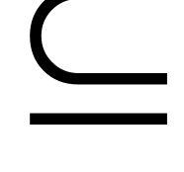

Proof - Step 1:
Context-Free
Languages
(Grammars)
Languages
Accepted by
PDAs
Convert any context-free grammar
to a PDA with:

Slide 3



Proof - Step 2:
Context-Free
Languages
(Grammars)
Languages
Accepted by
PDAs
Convert any PDA to a context-free
grammar with:

Slide 4


Proof of (1)
We will convert arbitrary grammar
to a PDA such that:
simulates leftmost derivations of

Slide 5
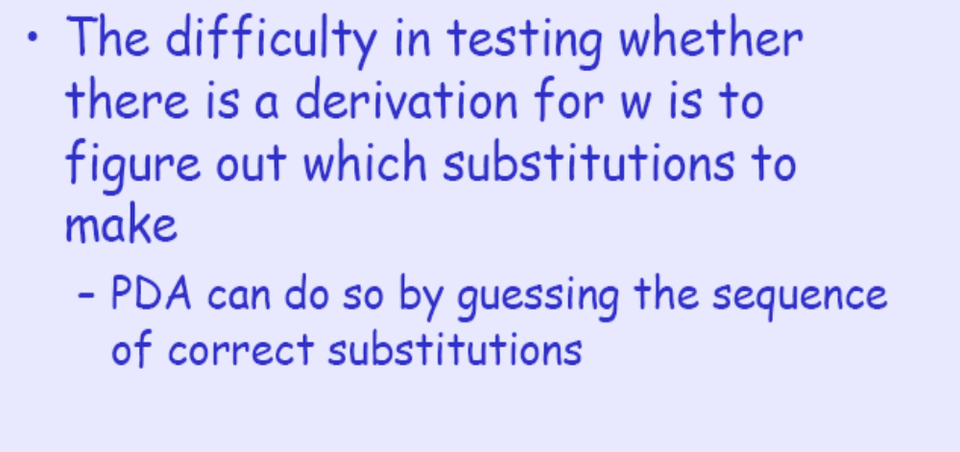
Proof of (1)

Slide 6
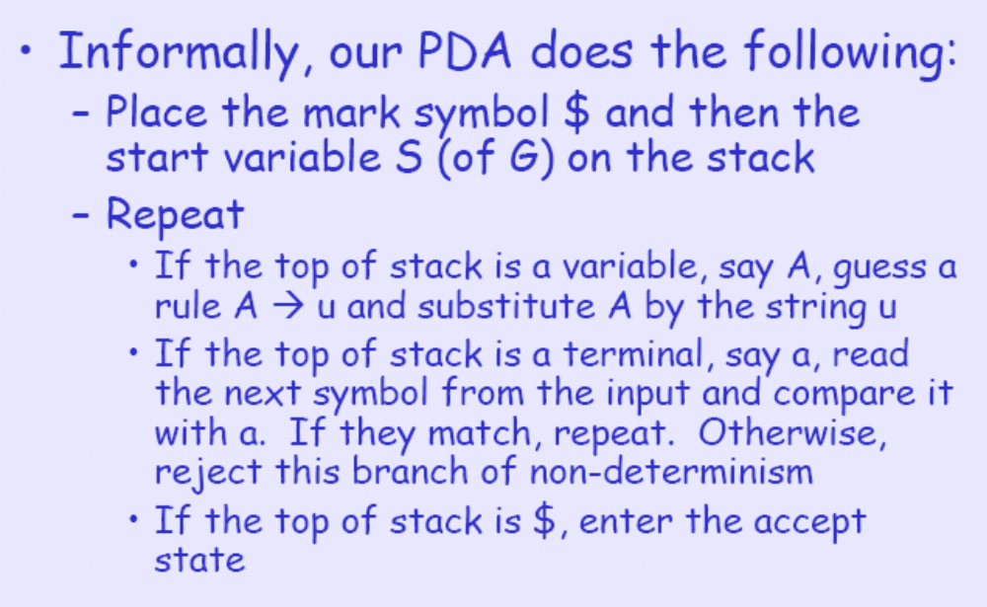
Proof of (1)

Slide 7
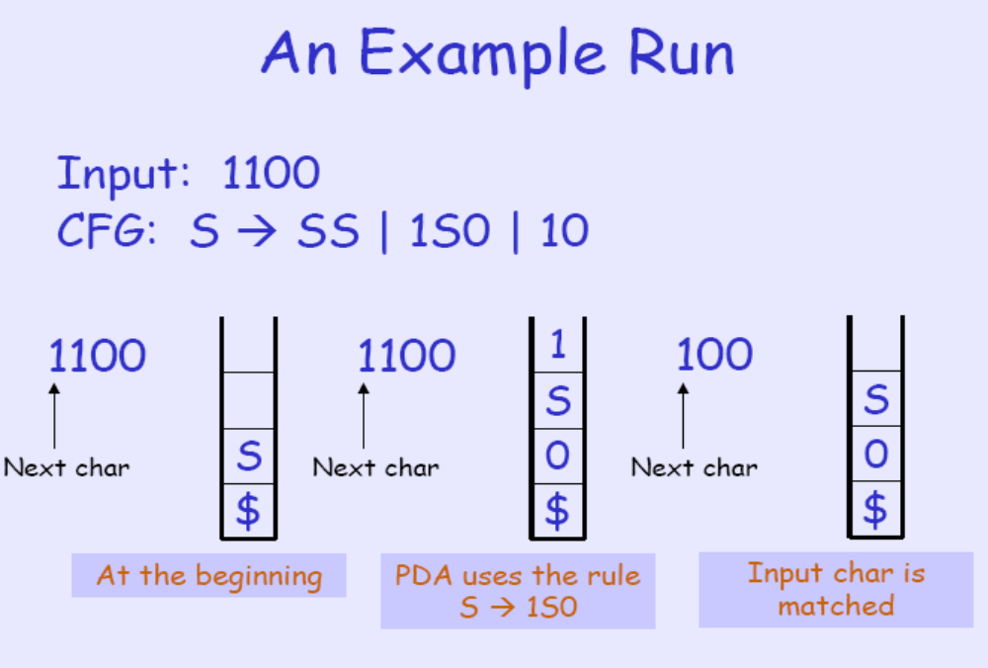
Proof of (1)

Slide 8
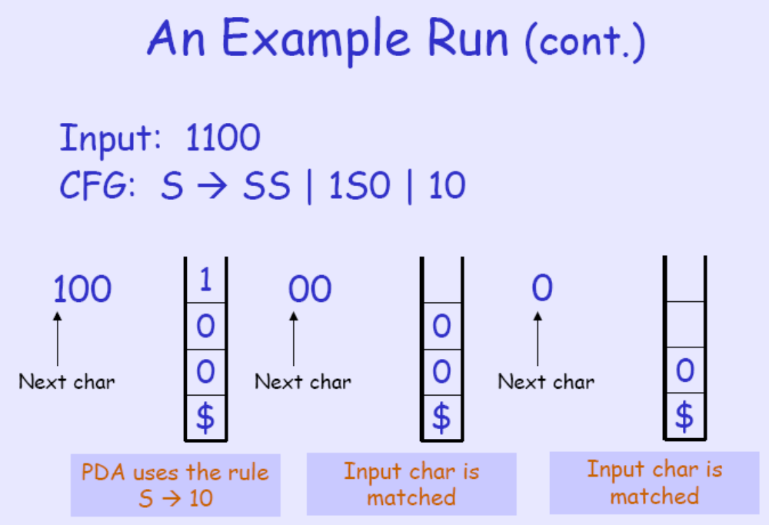
Proof of (1)

Slide 9
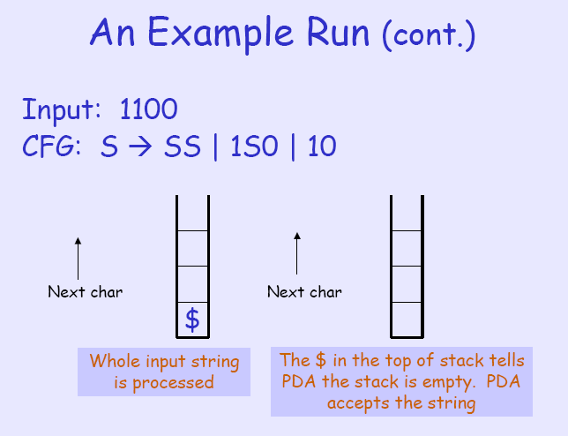
Proof of (1)

Slide 10
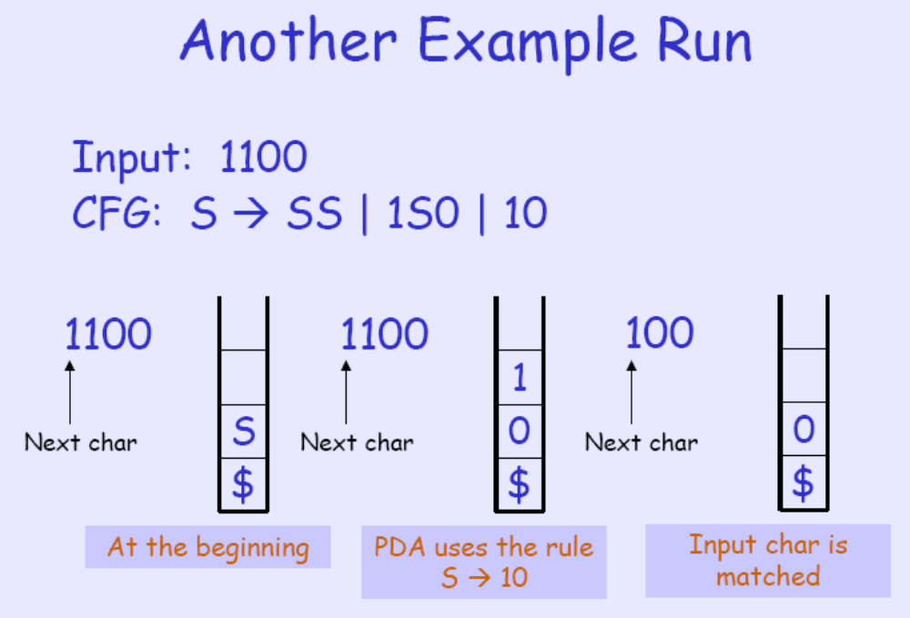
Proof of (1)

Slide 11
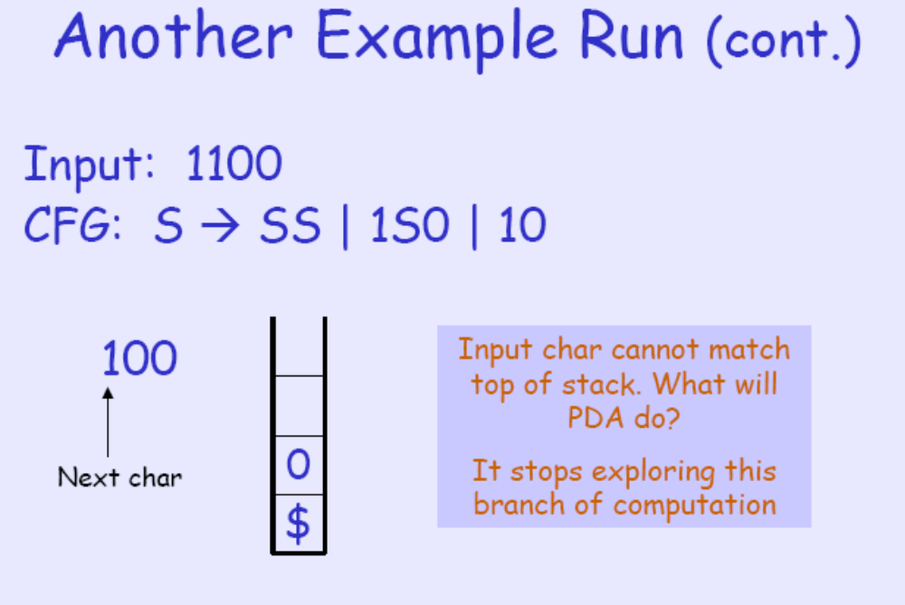
Proof of (1)

Slide 12
Proof of (1): Implementation Detail
We can see that, an input string w is accepted by our PDA if and only if there is a derivation from S to w.
What remains is to show that such a PDA can be constructed
Pushing $, pushing S, or matching input chars with terminals in the stack is easy
Difficulty: How to replace a variable in the top of stack by right side of a corresponding rule? (E.g., top of stack is A and we have with a rule A → xyz. How to replace A by xyz?)
By using dummy states

Slide 13
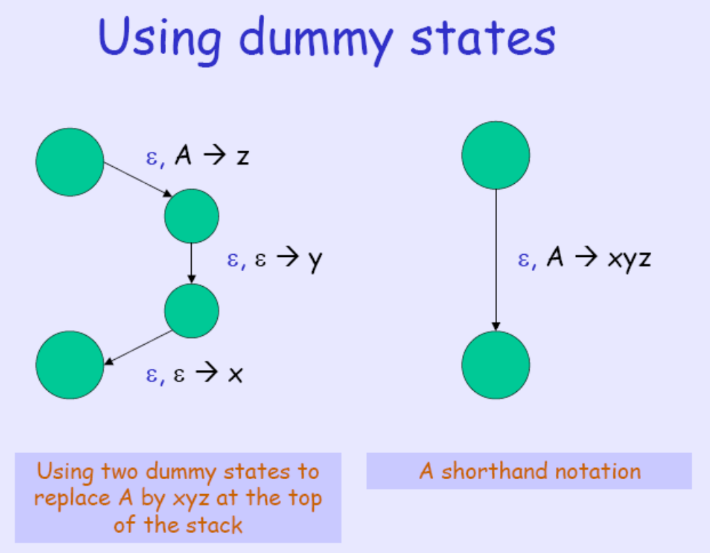
Proof of (1)

Slide 14
Proof of (1)

Slide 15
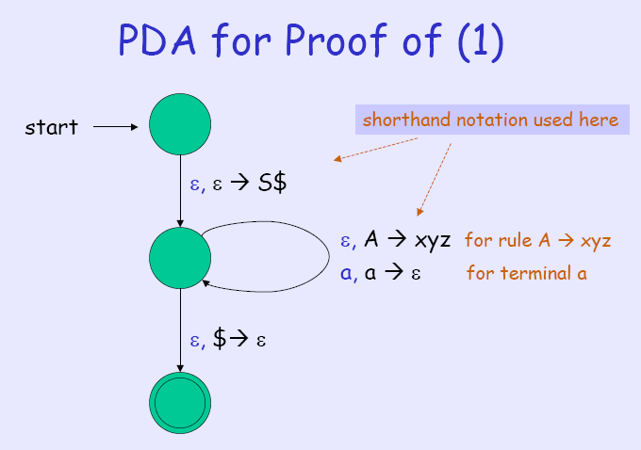
Proof of (1)
PDA的状态集
Q = {q_{start}, q_{loop}, q_{accept}}
转移函数
δ(q_{start},ε, ε)= {q_{loop},S$}
δ(q_{loop},ε,A) = {q_{loop},w|A->w是R中的一条规则}
δ(q_{loop}, a,a) = {q_{loop}, ε}
δ(q_{loop}, ε,$) = {q_{accept}, ε}

Slide 16
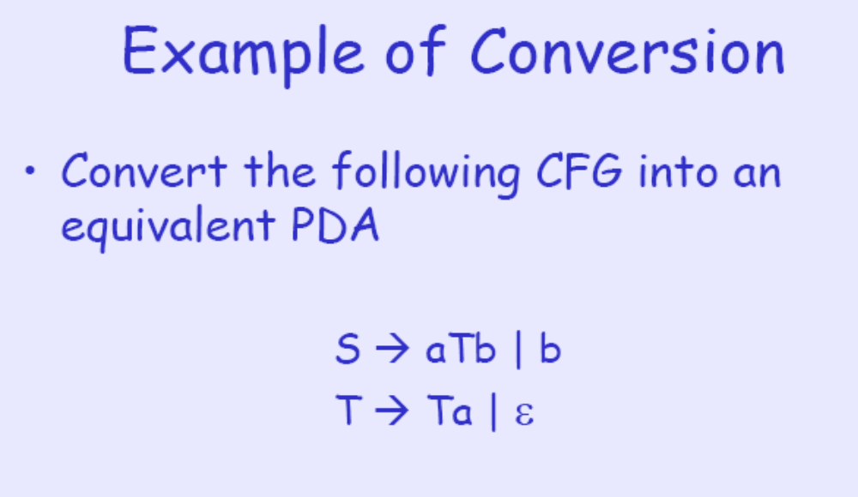
Proof of (1) s->aTb|b T->Ta|ε

Slide 17
Proof of (1) S->aTb|b,T->Ta|ε
q_{start}
ε, S→b
ε, ε →T
ε, ε→a
ε, ε→S$
ε, T→a
ε, ε→T
q_{loop}
ε, $→ε
ε, S →b
ε, T → ε
a, a → ε
b, b → ε
q_{accept}

Slide 18



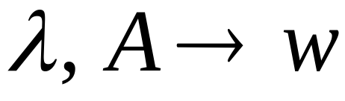
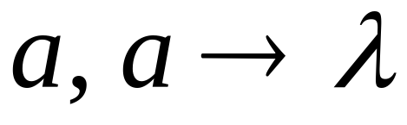
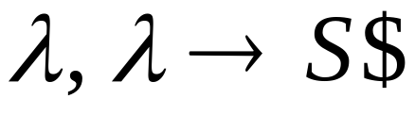
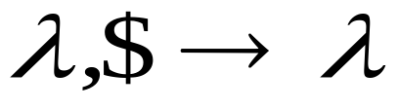



Convert grammar to PDA
For each
Production in
For each
Terminal in
Add transitions

Slide 19
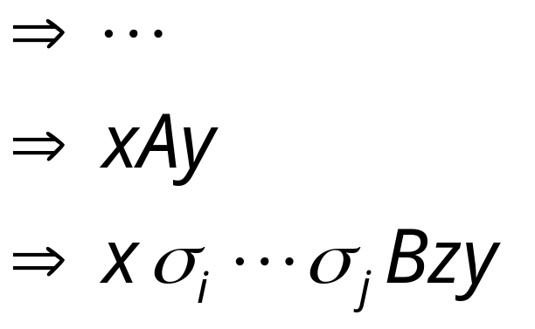
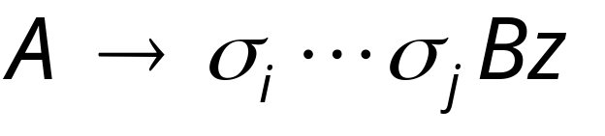
Grammar
Leftmost Derivation
Leftmost
variable
Variables
or terminals
Terminals
Production applied
Variables
or terminals
Terminals
Variable

Slide 20
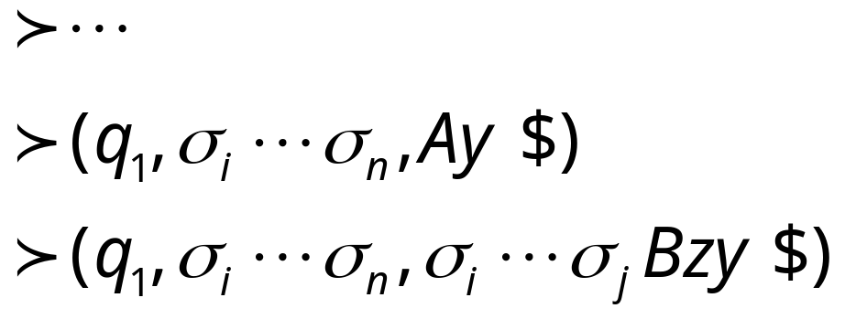
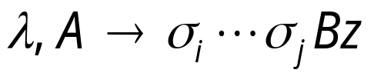


Grammar
Leftmost Derivation
PDA Computation
Production applied
Transition applied

Slide 21

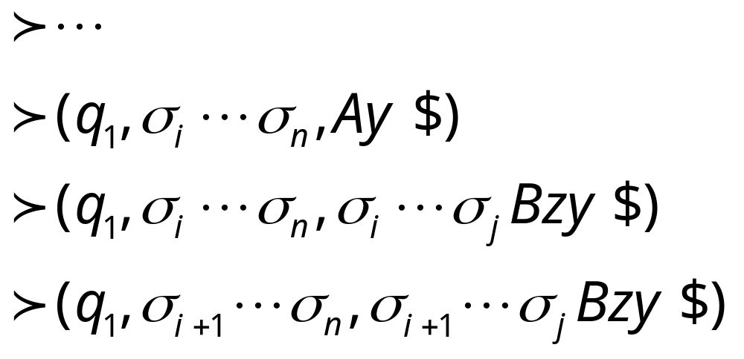
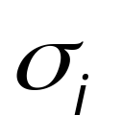
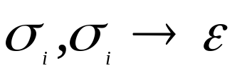


Grammar
Leftmost Derivation
PDA Computation
Transition applied
Read from input
and remove it from stack
Prof. Busch - LSU

Slide 22

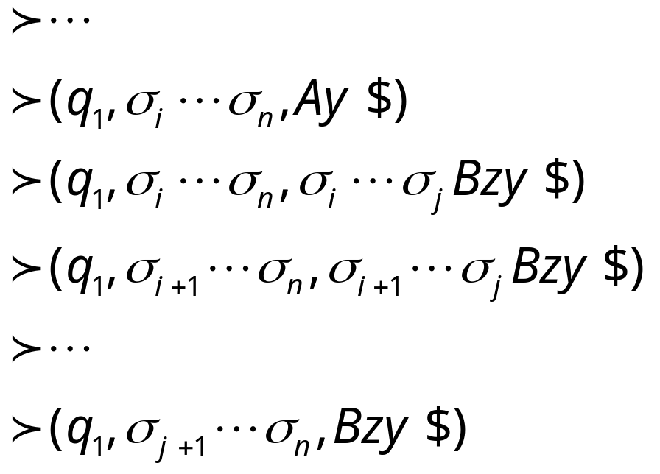
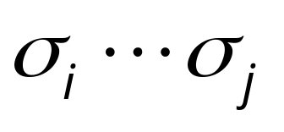
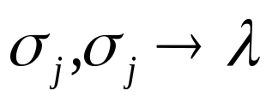
Grammar
Leftmost Derivation
PDA Computation
Last Transition applied
All symbols
have been removed from top of stack

Slide 23
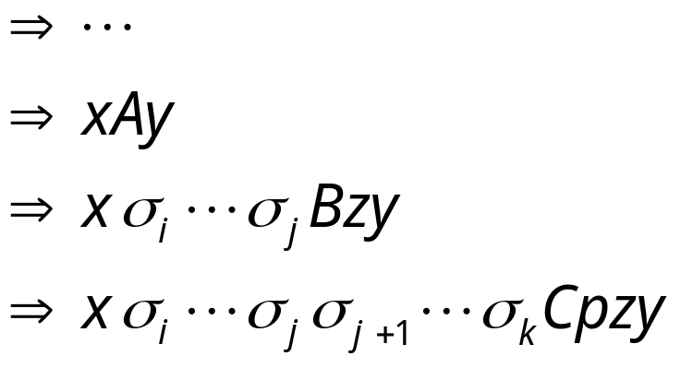
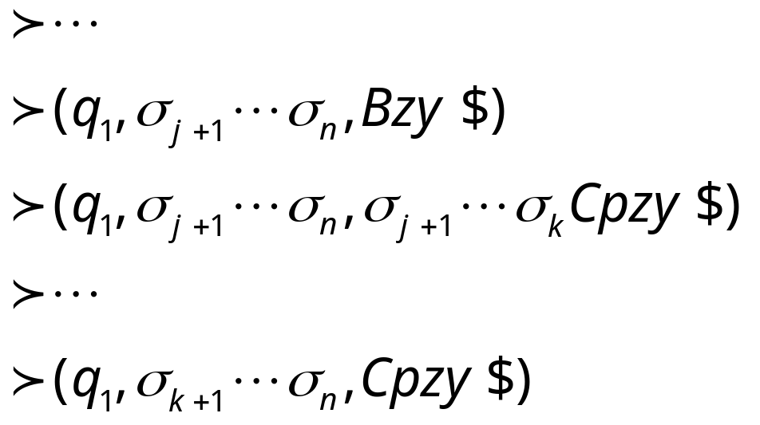
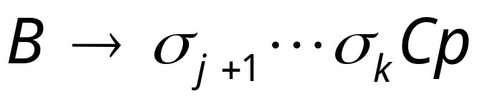
The process repeats with the next
leftmost variable
Production applied
And so on……

Slide 24
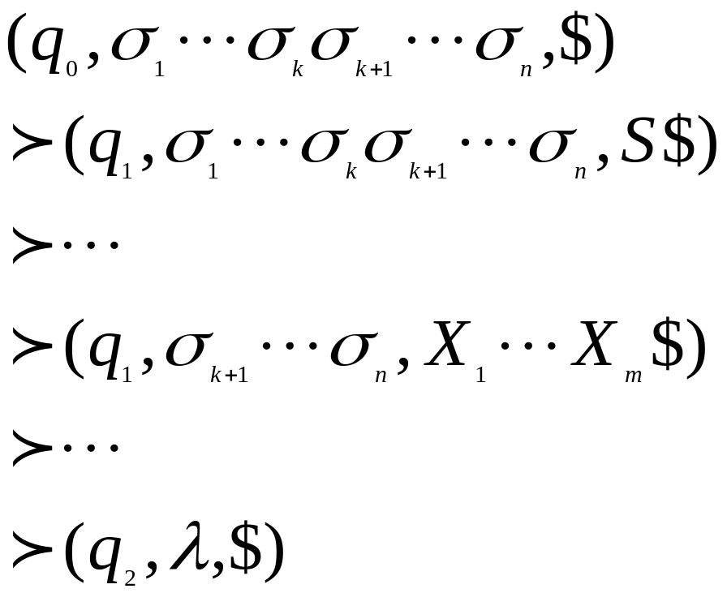
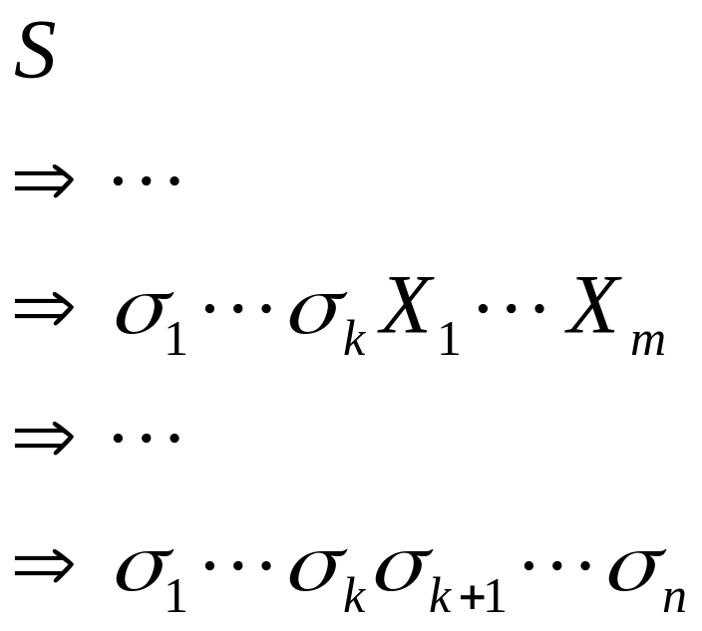
PDA simulates leftmost derivations
Grammar
Leftmost Derivation
PDA Computation
Scanned symbols
Stack contents

Slide 25


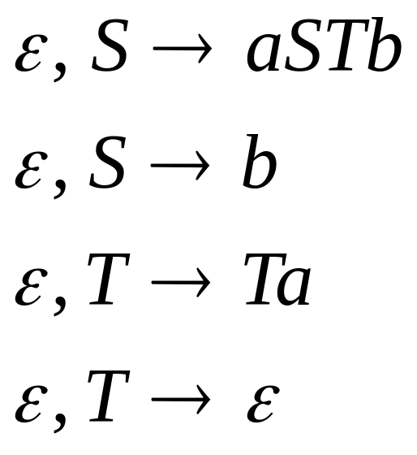

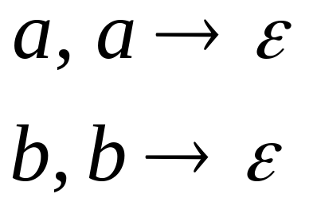
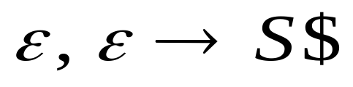
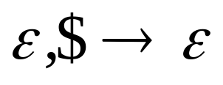

Derivation:
Input
Time 0
Stack

Slide 26


Derivation:
Input
Time 0
Stack

Slide 27


Derivation:
Input
Time 1
Stack

Slide 28
Derivation:
Input
Time 2
Stack

Slide 29

Derivation:
Input
Time 3
Stack

Slide 30
Derivation:
Input
Time 4
Stack

Slide 31
Derivation:
Input
Time 5
Stack

Slide 32
Derivation:
Input
Time 6
Stack

Slide 33
Derivation:
Input
Time 7
Stack

Slide 34
Derivation:
Input
Time 8
Stack

Slide 35
Derivation:
Input
Time 9
Stack
accept

Slide 36
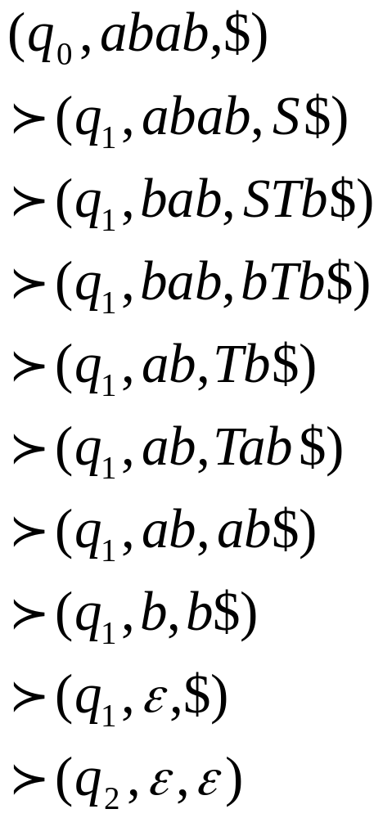
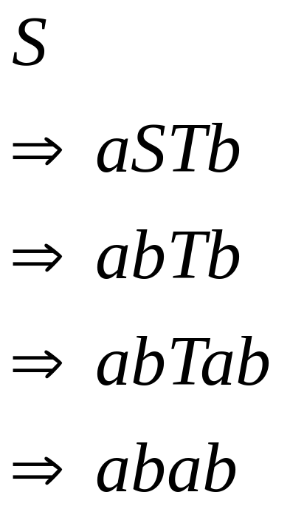
PDA computation
Grammar
derivation
s->aSTb|b T->Ta|ε

Slide 37
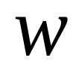
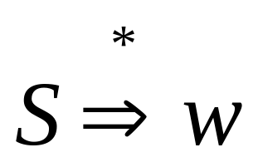
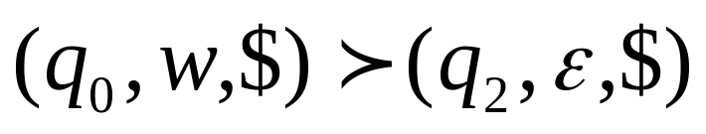
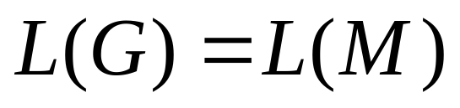
In general, it can be shown that:
Grammar
generates
string
If and
Only if
PDA
accepts
Therefore

Slide 38
Proof of CFG=PDA (2)
(2) If a language is recognized by a PDA, it can be generated by some CFG.
We show how to convert a PDA into an equivalent CFG.
Convert any PDA to a context-free
grammar with:
Notes:
Convert
PDAs
to
Context-Free Grammars

Slide 39
We can convert PDA to
a context-free grammar such that:
simulates computations of
with leftmost derivations

Slide 40
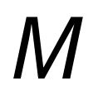
First modify PDA so that:
1. The PDA has a single accept state
2. Use new initial stack symbol #
3. On acceptance the stack contains only
stack symbol # (this symbol is not used in any transition)
4. Each transition either pushes a symbol
or pops a symbol but not both together

Slide 41
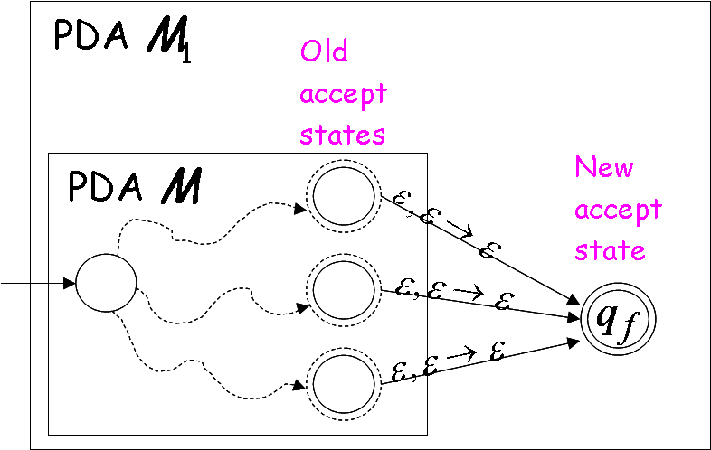
1. The PDA has a single accept state

Slide 42


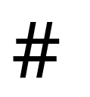
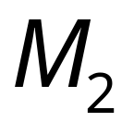
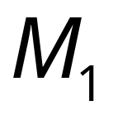
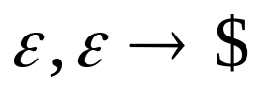
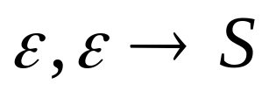
2. Use new initial stack symbol #
Top of stack
initial stack symbol of M
auxiliary stack symbol
new initial stack symbol
PDA
PDA
still thinks that S is the initial stack

Slide 43
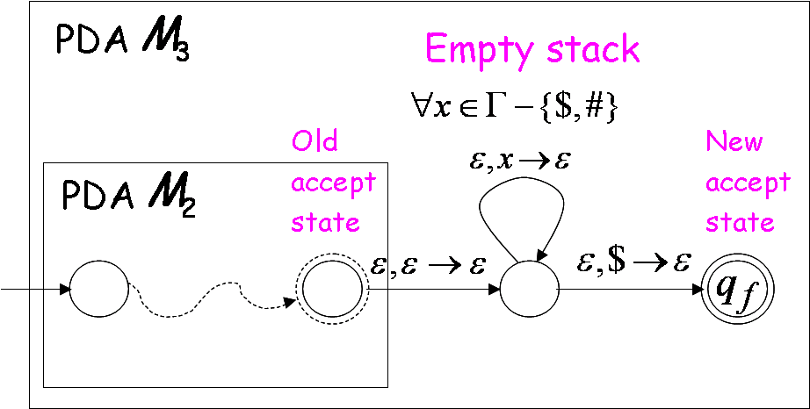
3. On acceptance the stack contains only
stack symbol #
(this symbol is not used in any transition)

Slide 44
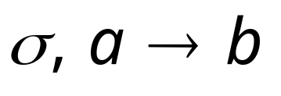
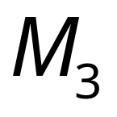





4. Each transition either pushes a symbol
or pops a symbol but not both together
PDA
PDA

Slide 45




PDA
PDA
Where is a symbol of the stack alphabet

Slide 46
PDA is the final modified PDA
Note that the new initial stack symbol #
is never used in any transition

Slide 47


Slide 48
Proof - Step 2:
Context-Free
Languages
(Grammars)
Languages
Accepted by
PDAs
Convert any PDA to a context-free
grammar with:

Slide 49

The Correct Grammar Construction
In grammar :
Variables:
States of PDA
Terminals: Input symbols of PDA

Slide 50


PDA
Kind 1: for each state
Grammar

Slide 51



PDA
Kind 2: for every three states
Grammar
That is, if we can get from p to r, and also from r to q, then we can get from p to q.

Slide 52




PDA
Kind 3: for every pair of such transitions
Grammar
That is, if we can get from p to r by reading a and pushing t, and we can get from s to q by reading b and popping t, then if we start with p, we can reach q by reading a, going from r to s, then reading b.

Slide 53



PDA
Initial state
Accept state
Grammar
Start variable

Slide 54














PDA
Example:

Slide 55

Grammar
Kind 1: from single states

Slide 56


Kind 2: from triplets of states
Start variable

Slide 57









Kind 3: from pairs of transitions

Slide 58





Suppose that a PDA is converted
to a context-free grammar
We need to prove that
or equivalently

Slide 59



We need to show that if has derivation:
(string of terminals)
Then there is an accepting computation in :
with input string

Slide 60


We will actually show that if has derivation:
Then there is a computation in :

Slide 61

Therefore:
Since there is no transition
with the # symbol

Slide 62




Lemma:
If (string of terminals)
then there is a computation
from state to state on string
which leaves the stack empty:

Slide 63



Proof Intuition:
Type 2
Case 1:
Type 3
Case 2:

Slide 64

Type 2
Case 1:

Slide 65

Type 3
Case 2:

Slide 66
Formal Proof:
We formally prove this claim
by induction on the number
of steps in derivation:
number of steps

Slide 67





Induction Basis:
(one derivation step)
A Kind 1 production must have been used:
Therefore, and
This computation of PDA trivially exists:

Slide 68


Induction Hypothesis:
derivation steps
suppose it holds:

Slide 69

Induction Step:
derivation steps
We have to show:

Slide 70
derivation steps
Type 2
Case 1:
Type 3
Case 2:

Slide 71




Type 2
Case 1:
steps
We can write
At most steps
At most steps

Slide 72


At most steps
At most steps
From induction
hypothesis, in PDA:
From induction
hypothesis, in PDA:

Slide 73


since

Slide 74


Type 3
Case 2:
steps
We can write
At most steps

Slide 75

At most steps
From induction hypothesis,
the PDA has computation:

Slide 76

Type 3
Grammar contains production
And PDA Contains transitions

Slide 77




Slide 78




We know
We also know
Therefore:

Slide 79


since
END OF PROOF

Slide 80



So far we have shown:
With a similar proof we can show
Therefore:
Prof. Busch - LSU

Slide 81

Any Questions?

